Slide 1
CIS CONTROL 18: APPLICATION SOFTWARE SECURITY-III
APPLICATION SOFTWARE SECURITY

Slide 2
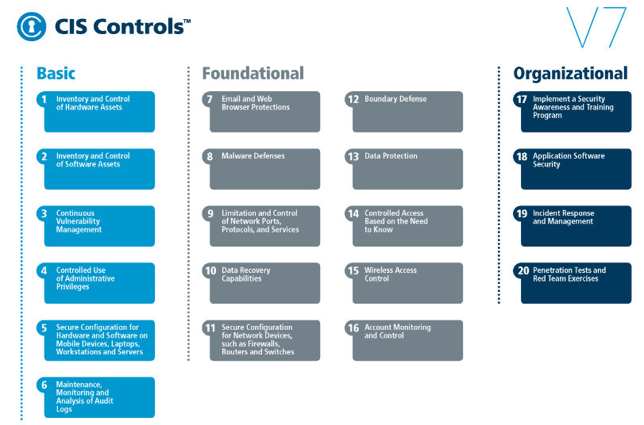
CIS CONTROL 18: APPLICATION SOFTWARE SECURITY-III
https://www.cisecurity.org/controls/

Slide 3
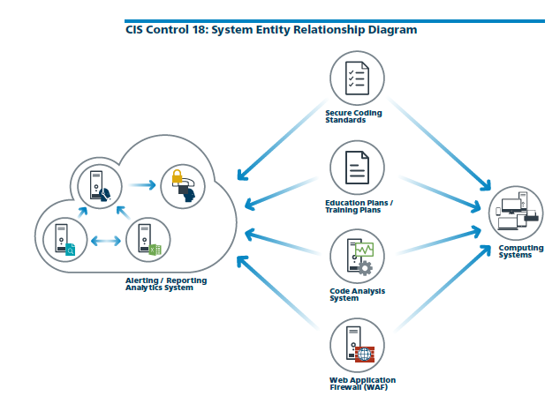
CIS CONTROL 18: APPLICATION SOFTWARE SECURITY-III
https://www.cisecurity.org/controls/

Slide 4
CIS CONTROL 18: APPLICATION SOFTWARE SECURITY-III
18.9: Separate Production and Non-Production Systems
Maintain separate environments for production and nonproduction systems. Developers should not have unmonitored access to production environments.

Slide 5
CIS CONTROL 18: APPLICATION SOFTWARE SECURITY-III
18.10: Deploy Web Application Firewalls (WAFs)
Protect web applications by deploying web application firewalls (WAFs) that inspect all traffic flowing to the web application for common web application attacks.

Slide 6
CIS CONTROL 18: APPLICATION SOFTWARE SECURITY-III
18.10: Deploy Web Application Firewalls (WAFs)
…For applications that are not web-based, specific application firewalls should be deployed if such tools are available for the given application type. If the traffic is encrypted, the device should…

Slide 7
CIS CONTROL 18: APPLICATION SOFTWARE SECURITY-III
18.10: Deploy Web Application Firewalls (WAFs)
...either sit behind the encryption or be capable of decrypting the traffic prior to analysis. If neither option is appropriate, a host-based web application firewall should be deployed.

Slide 8
CIS CONTROL 18: APPLICATION SOFTWARE SECURITY-III
18.11: Use Standard Hardening Configuration Templates for Databases
For applications that rely on a database, use standard hardening configuration templates. All systems that are part of critical business processes should also be tested.

